Slide 1


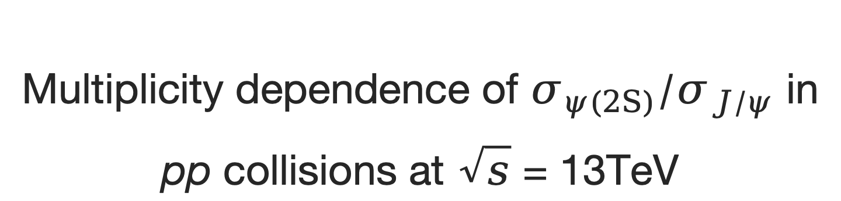
Multiplicity dependence of $σ_{ψ(2S)}/σ_{J/ψ}$ in pp collisions at $\sqrt{s}$ = 13TeV
Speaker: Youen Kang
(on behalf of the LHCb collaboration)
Institute: Tsinghua University

Slide 2
Outline
Introduction
Analysis
Results
Summary and outlook

Slide 3
Introduction

Slide 4
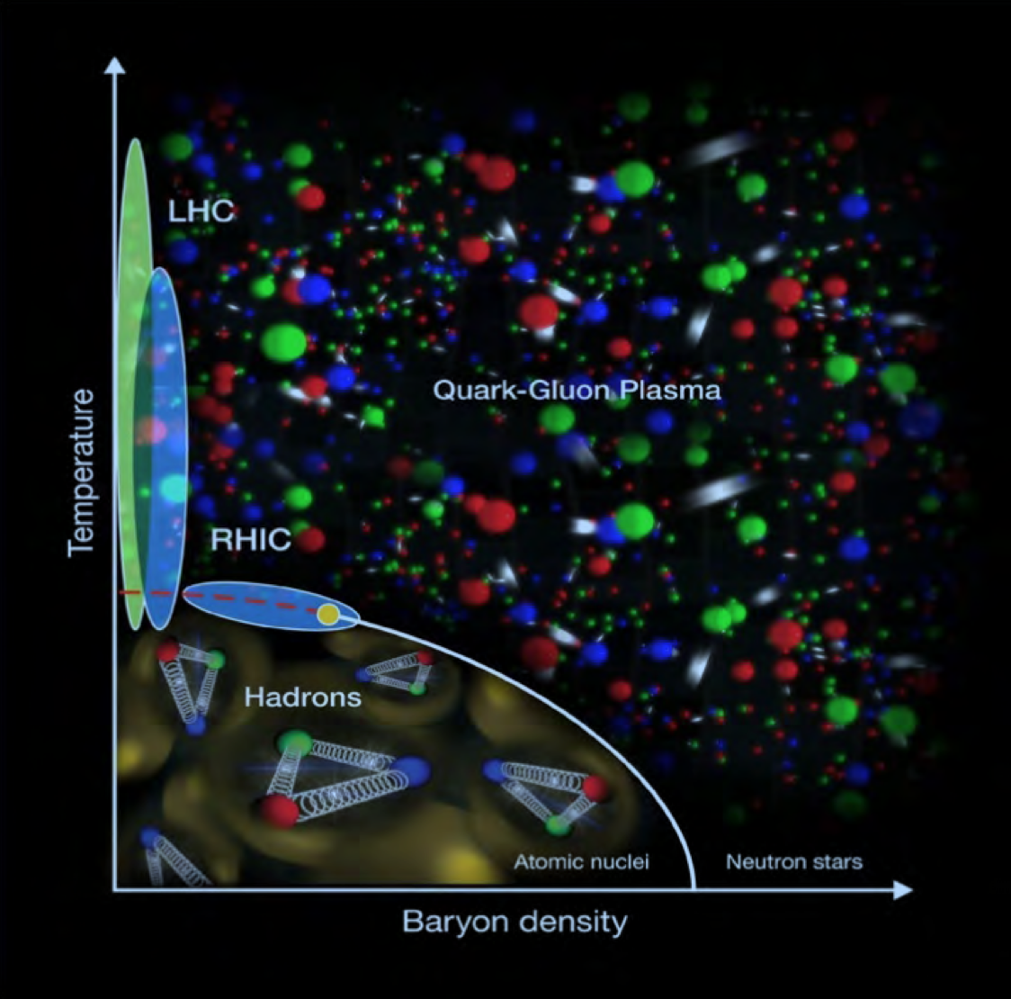
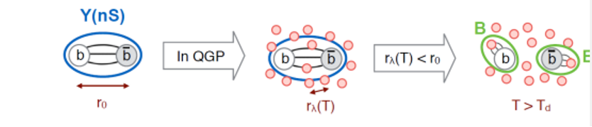
Quark-gluon plasma
Quark-Gluon Plasma (QGP):
A thermally equilibrated system where partons are deconfined
Achieve either by heating or compression of nuclei
Exist in the early stage of universe and ultra-relativistic energy heavy ion collisions (Big&Little Bang)
Color screening:
High density of free color charges leads to color screening and dissociation of heavy quarkonium.
A schematic of QCD phase diagram

Slide 5
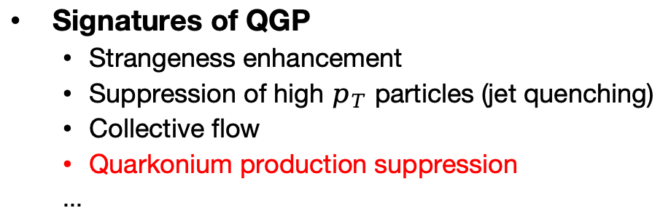
Collision systems and nuclear matter effects
Collision Systems
A-A collisions: Hot Nuclear Matter (HNM) effect dominates, related to the QGP production
p-A collisions: Cold Nuclear Matter (CNM) effect dominates,
Energy loss in multi-particles scattering
Modification of nuclear Parton Distribution Functions (nPDFs)
Cronin effect, etc.
pp collisions: No nuclear matter effect expected to exist
Large systems
Small systems
Signatures of QGP
Strangeness enhancement
Suppression of high $p_{T}$ particles (jet quenching)
Collective flow
Quarkonium production suppression
...
Has been observed in Large and high-multiplicity small systems.

Slide 6
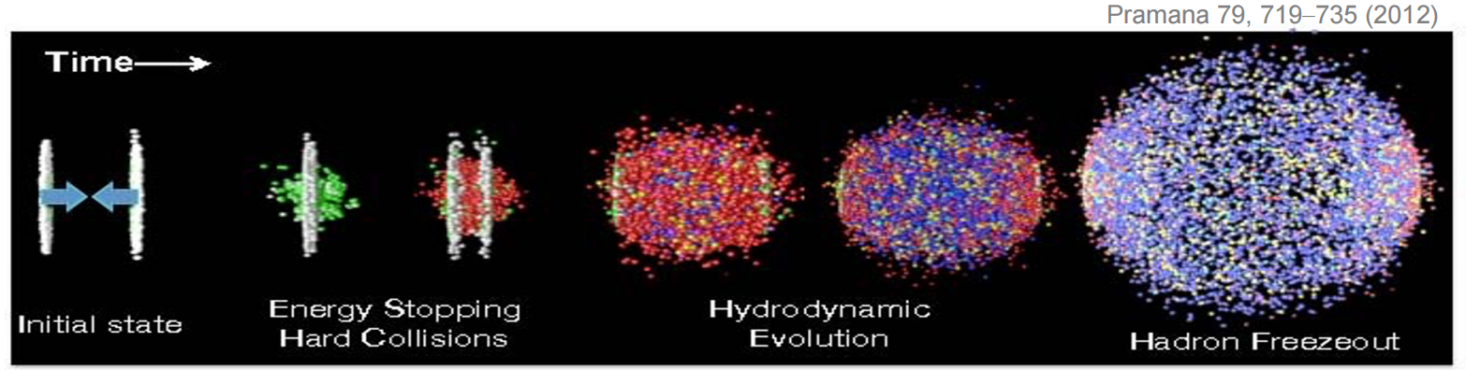
Heavy quarkonium production
Heavy quarkonium production:
Produced in intial hard scattering, experiencing the whole time-evolution of collisions
Sensitive to nuclear matter effect
Good probe for final state effect like co-mover effect
Excited-to-ground production ratio:
Sensitive to temperature-dependent effect, like sequential melting
Initial-state effects like nPDFs, multi-scattering energy-loss will cancel
Probe for potential existence of QGP and final-state effect like co-mover effect: ‘Quarkonia are suppressed by interaction with the co-moving medium, constituted by particles with similar rapidities.’ [JHEP 03 (2019) 063]
Both QGP and final-state effect are multiplicity-dependent

Slide 7
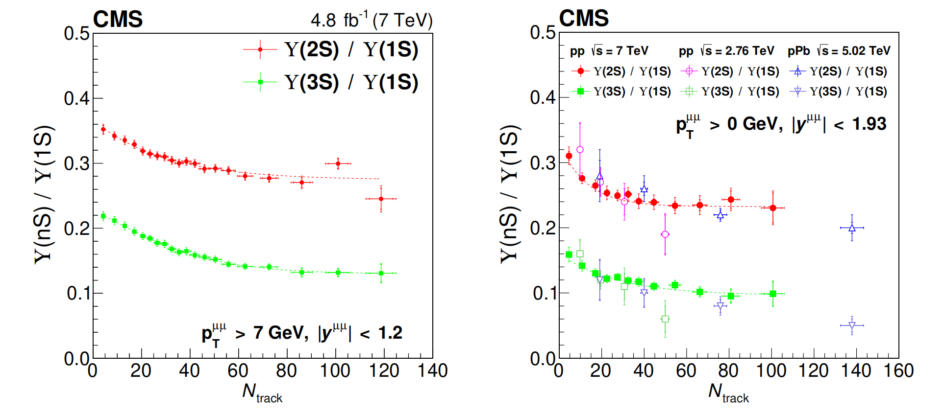
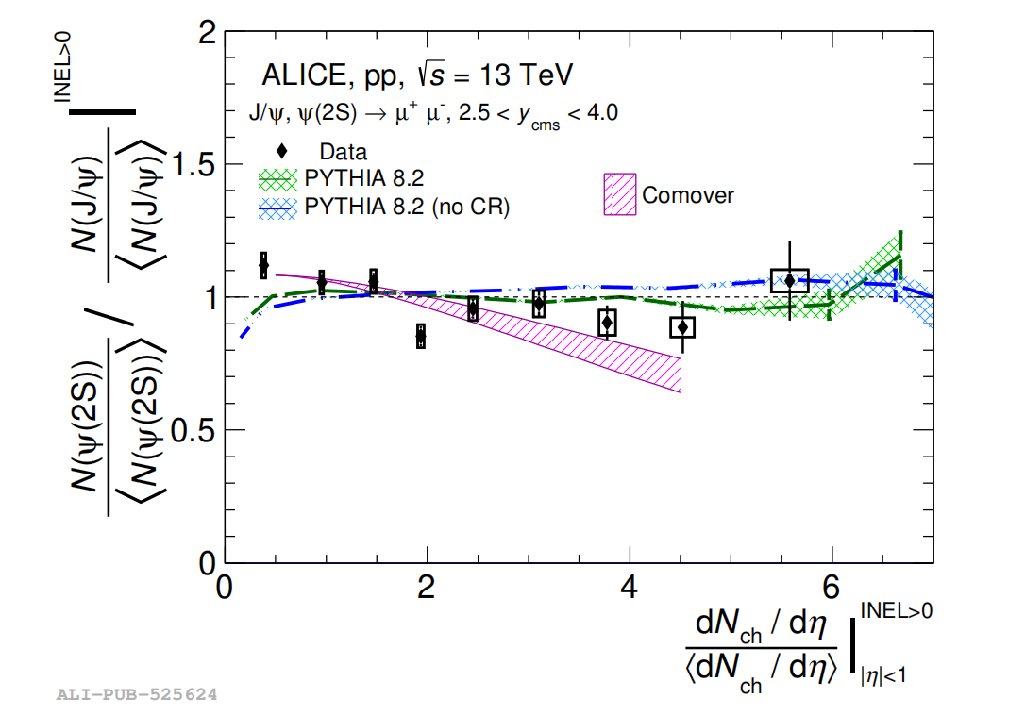
Quarkonium production ratio v.s. multiplicity
CMS [JHEP11(2020)001]
ALICE [JHEP 06 (2023) 147]
Multiplicity measured in: $−2.4<η<2.4$ $−0.9<η<0.9$
Production measured in : $−1.2<y<1.2$ $2.5<y<4$

Slide 8
Analysis

Slide 9
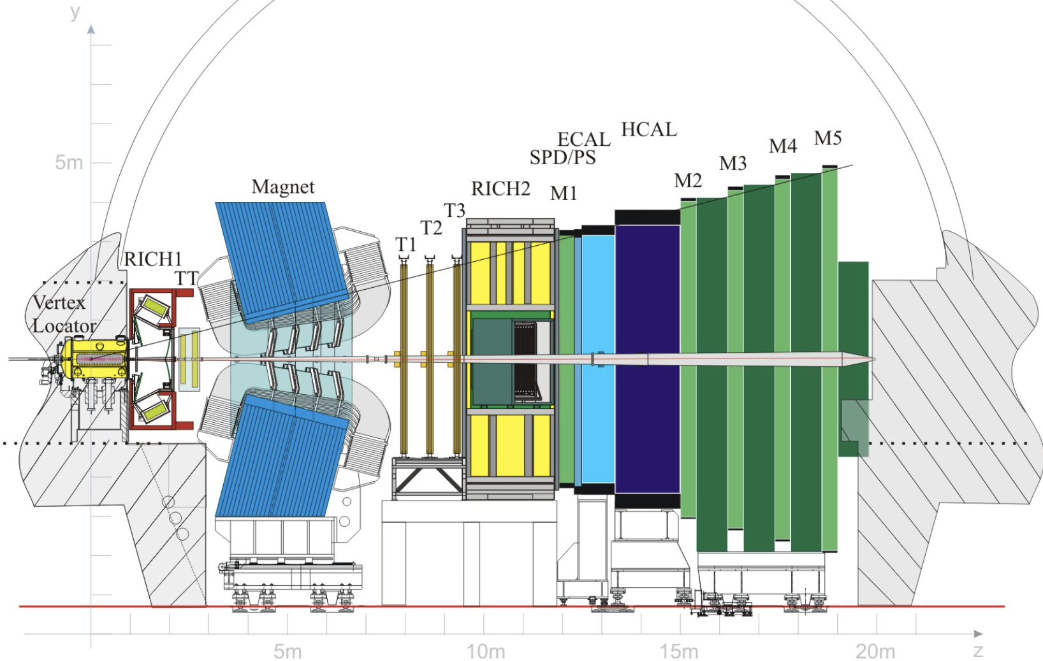
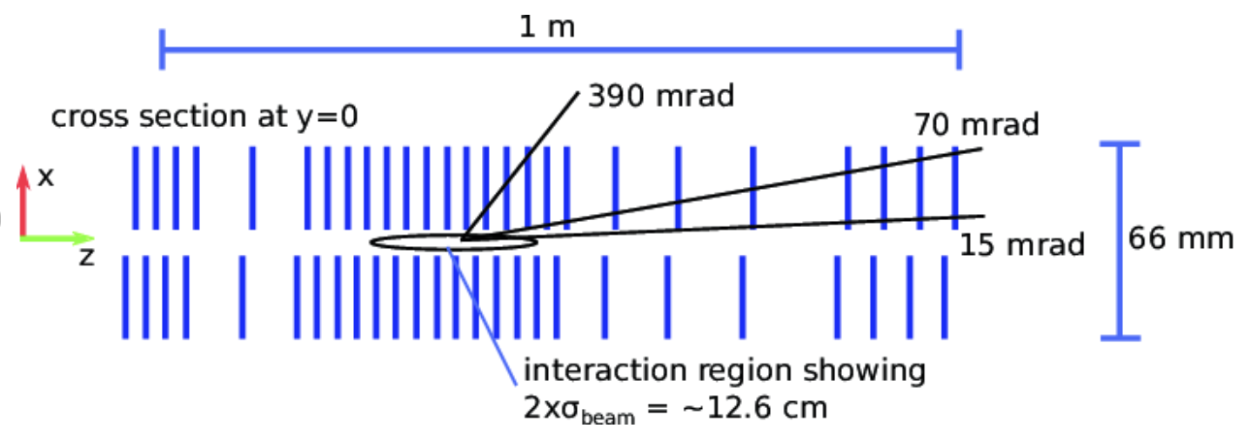
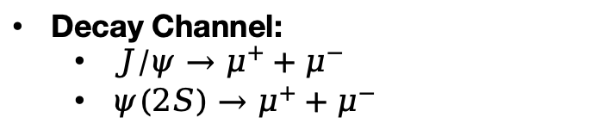
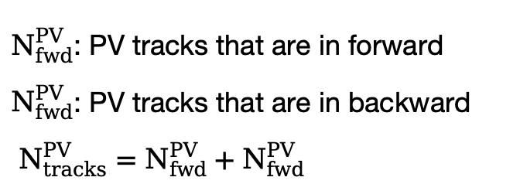
LHCb detector
LHCb detector
$N_{fwd}^{PV}$: PV tracks that are in forward
$N_{fwd}^{PV}$: PV tracks that are in backward
$N_{tracks}^{PV}=N_{fwd}^{PV}+N_{fwd}^{PV}$
Decay Channel:
$J/ψ→μ^{+}+μ^{−}$
$ψ(2S)→μ^{+}+μ^{−}$

Slide 10
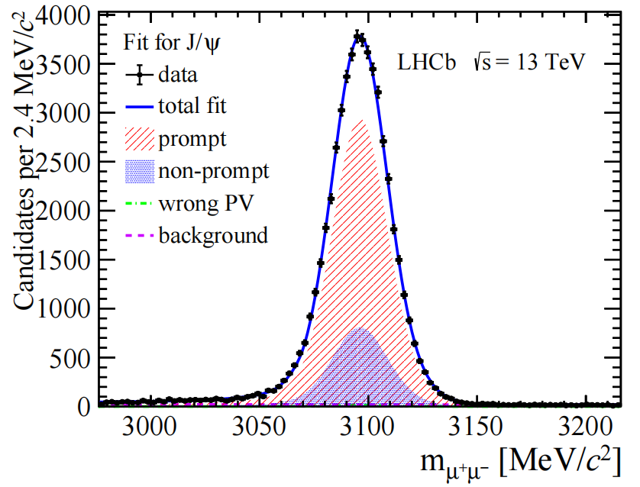
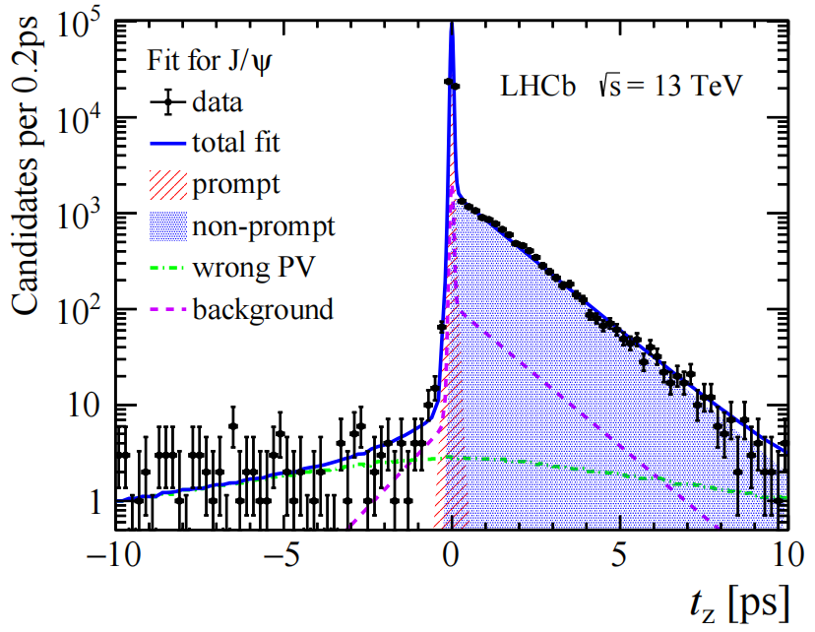
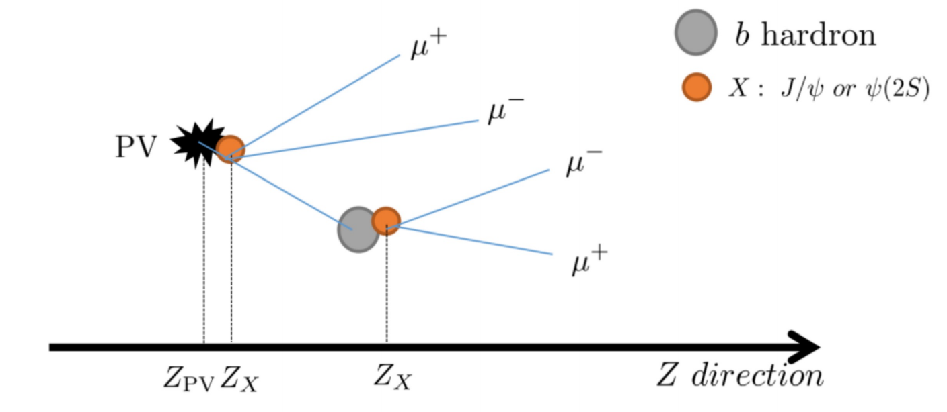
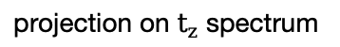
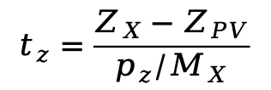
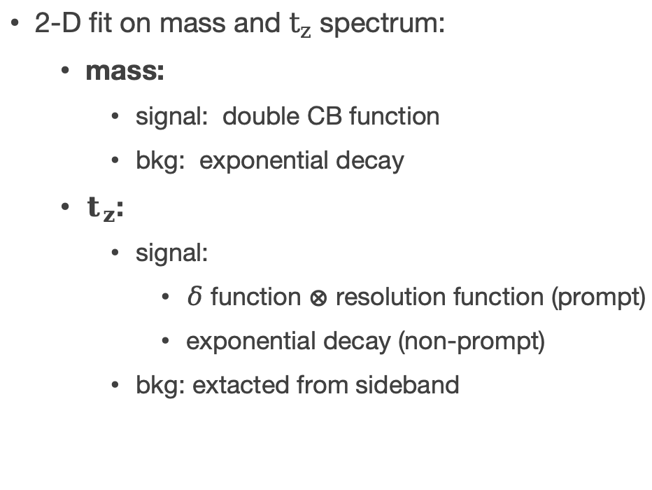
Signal extraction
2-D fit on mass and $t_{z}$ spectrum:
mass:
signal: double CB function
bkg: exponential decay
$t_{z}$:
signal:
$δ$ function $⊗$ resolution function (prompt)
exponential decay (non-prompt)
bkg: extacted from sideband
LHCb preliminary
LHCb preliminary
projection on mass spectrum
projection on $t_{z}$ spectrum
$$t_{z}=\frac{Z_{X}−Z_{PV}}{p_{z}/M_{X}}$$
Definition of pseudo-decay time:

Slide 11
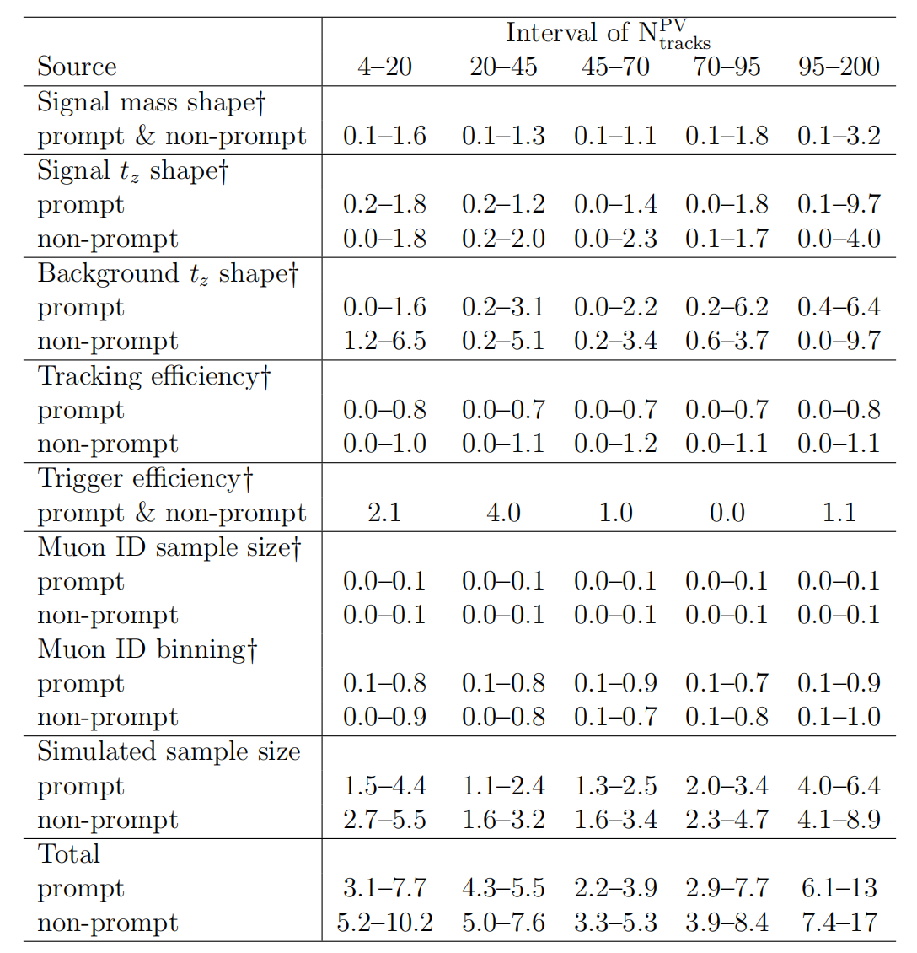
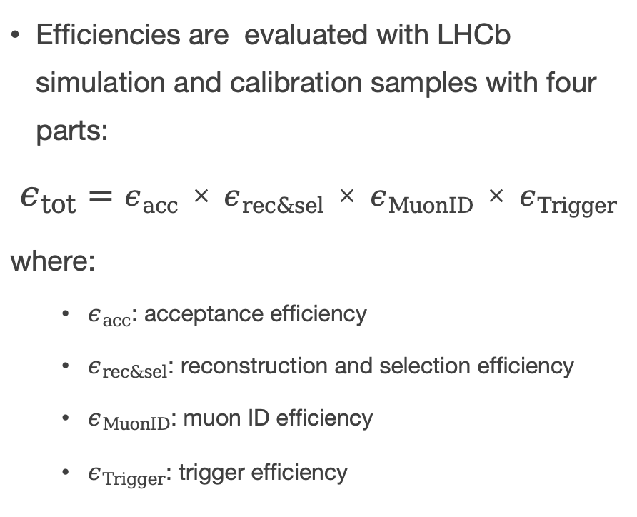
Efficiencies correction and uncertainties
Efficiencies are evaluated with LHCb simulation and calibration samples with four parts:
$$ε_{tot}=ε_{acc}×ε_{rec\&sel}×ε_{MuonID}×ε_{Trigger}$$
where:
$ε_{acc}$: acceptance efficiency
$ε_{rec\&sel}$: reconstruction and selection efficiency
$ε_{MuonID}$: muon ID efficiency
$ε_{Trigger}$: trigger efficiency

Slide 12
Result

Slide 13
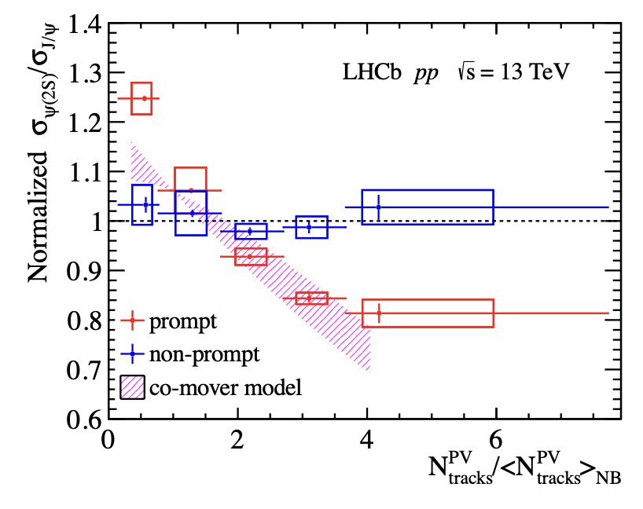
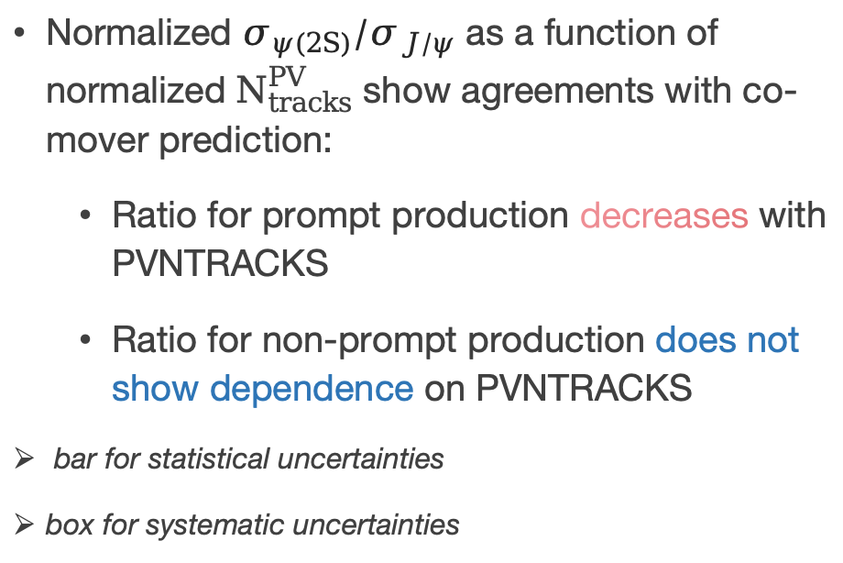
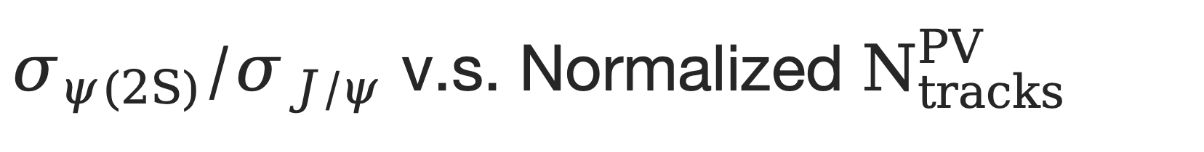
$σ_{ψ(2S)}/σ_{J/ψ}$ v.s. Normalized $N_{tracks}^{PV}$
Normalized $σ_{ψ(2S)}/σ_{J/ψ}$ as a function of normalized $N_{tracks}^{PV}$ show agreements with co-mover prediction:
Ratio for prompt production decreases with PVNTRACKS
Ratio for non-prompt production does not show dependence on PVNTRACKS
bar for statistical uncertainties
box for systematic uncertainties
LHCb preliminary
From: LHCb-PAPER-2023-035

Slide 14
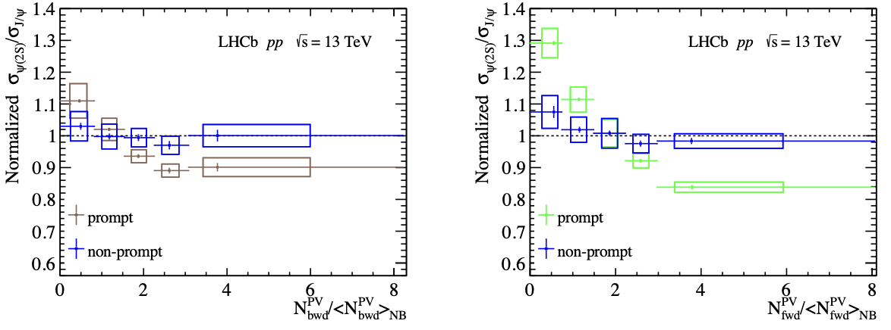
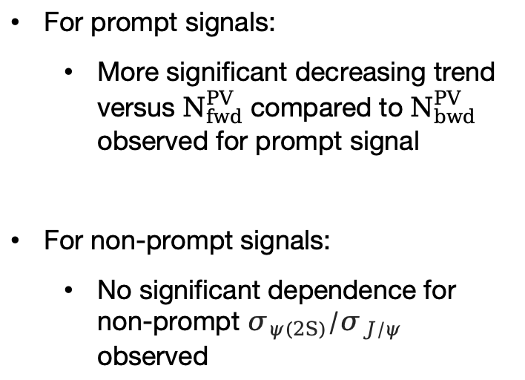
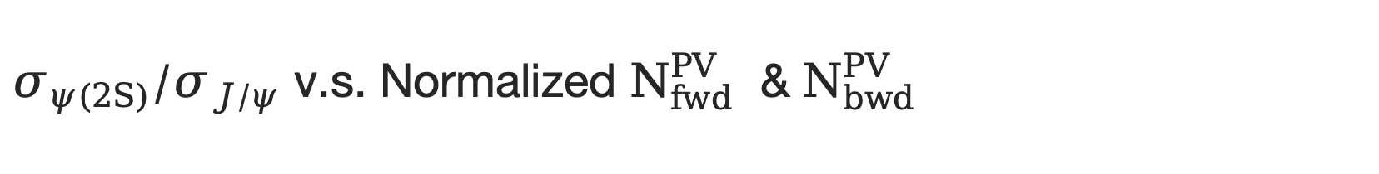
$σ_{ψ(2S)}/σ_{J/ψ}$ v.s. Normalized $N_{fwd}^{PV}$ & $N_{bwd}^{PV}$
For prompt signals:
More significant decreasing trend versus $N_{fwd}^{PV}$ compared to $N_{bwd}^{PV}$ observed for prompt signal
For non-prompt signals:
No significant dependence for non-prompt $σ_{ψ(2S)}/σ_{J/ψ}$ observed
LHCb preliminary
LHCb preliminary
$N_{bwd}^{PV}$: $−5.2<η<−1.5$ $N_{fwd}^{PV}$: $−5.2<η<−1.5$
From: LHCb-PAPER-2023-035

Slide 15
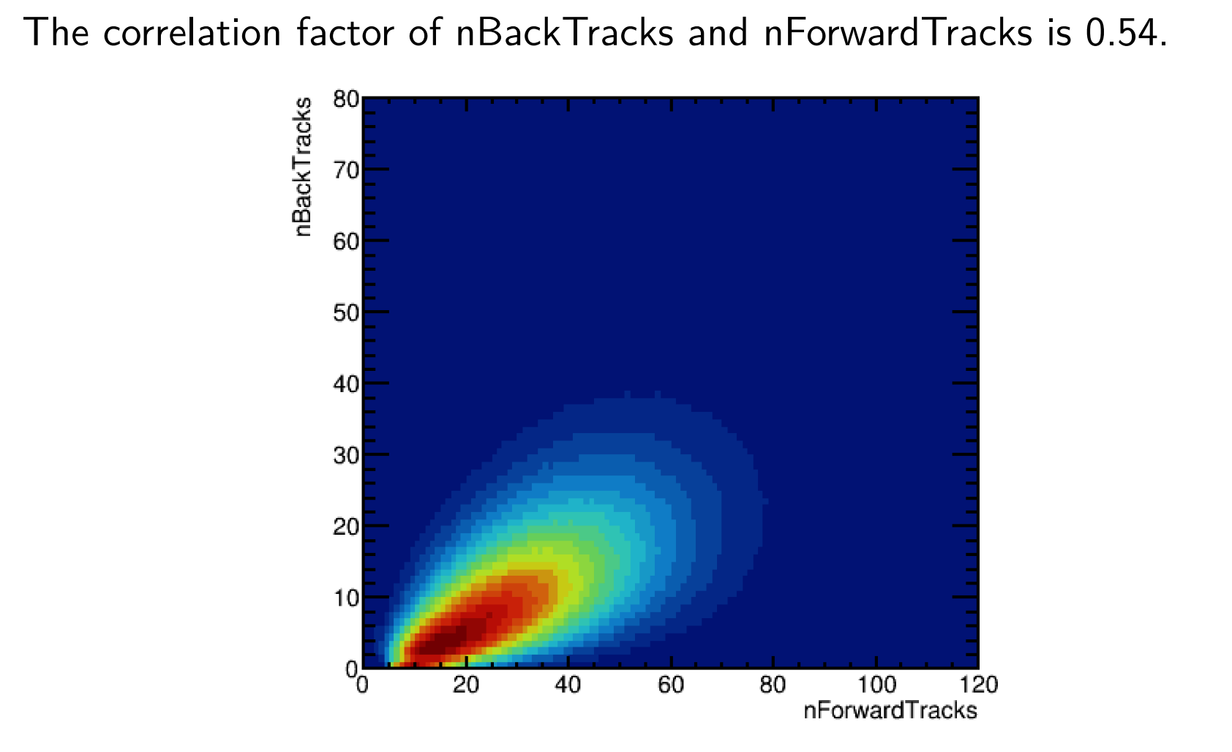
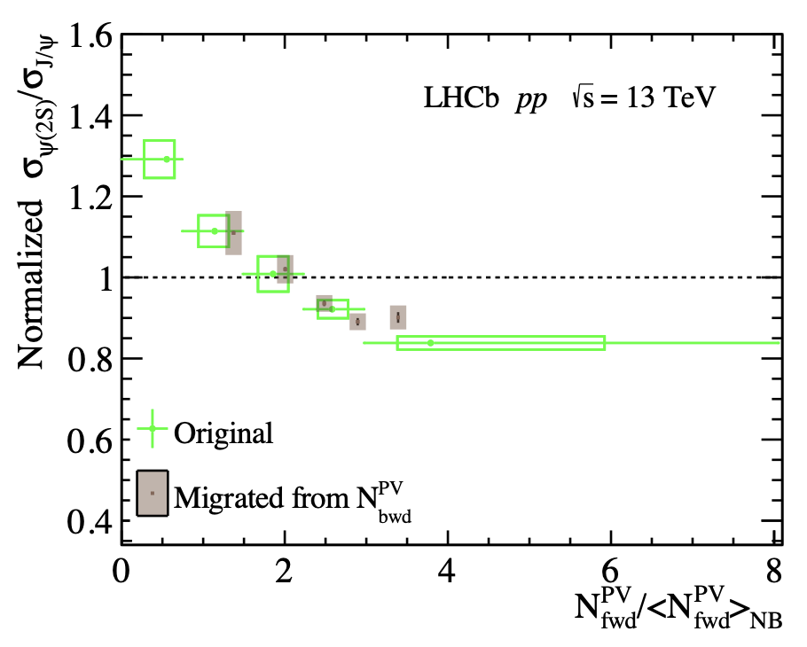

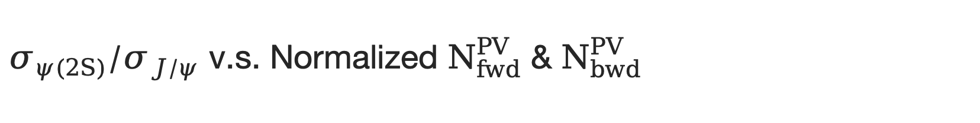
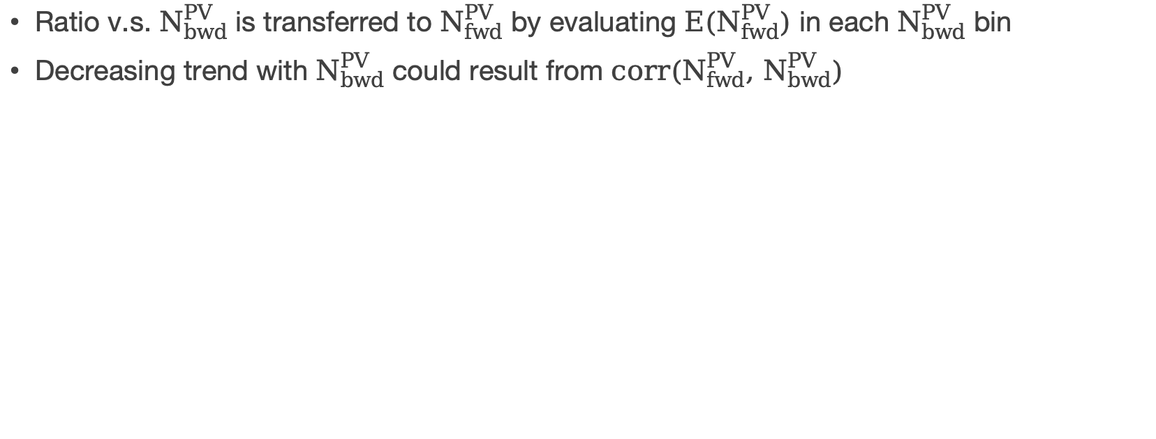
$σ_{ψ(2S)}/σ_{J/ψ}$ v.s. Normalized $N_{fwd}^{PV}$ & $N_{bwd}^{PV}$
Ratio v.s. $N_{bwd}^{PV}$ is transferred to $N_{fwd}^{PV}$ by evaluating ${E(N}_{fwd}^{PV})$ in each $N_{bwd}^{PV}$ bin
Decreasing trend with $N_{bwd}^{PV}$ could result from ${corr(N}_{fwd}^{PV}, N_{bwd}^{PV})$
LHCb preliminary
LHCb preliminary
$${corr(N}_{fwd}^{PV}, N_{bwd}^{PV})=0.54$$
From: LHCb-PAPER-2023-035

Slide 16
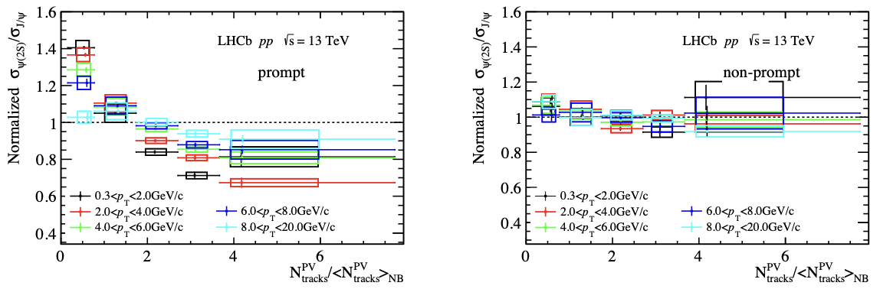
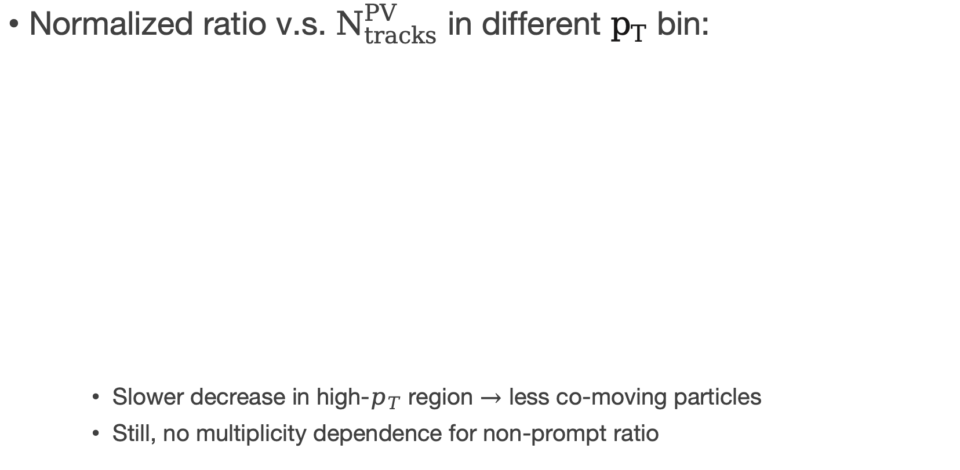

Result in different $p_{T}$ bin
Normalized ratio v.s. $N_{tracks}^{PV}$ in different $p_{T}$ bin:
Slower decrease in high-$p_{T}$ region $→$ less co-moving particles
Still, no multiplicity dependence for non-prompt ratio
LHCb preliminary
LHCb preliminary
From: LHCb-PAPER-2023-035

Slide 17
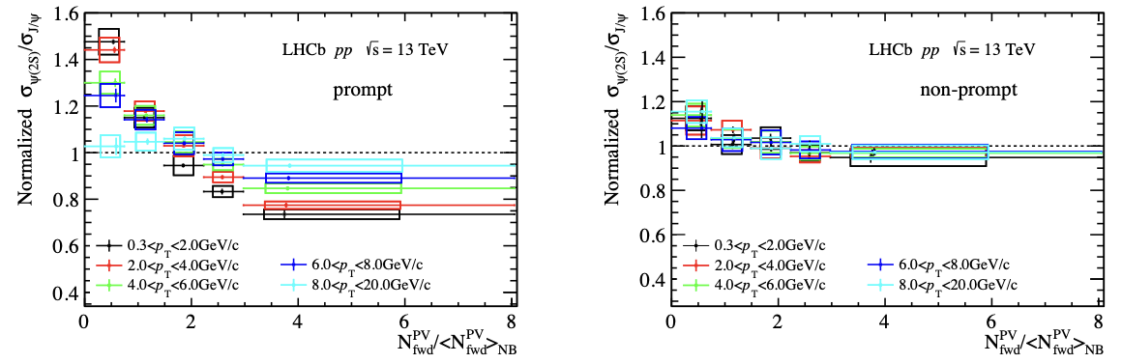
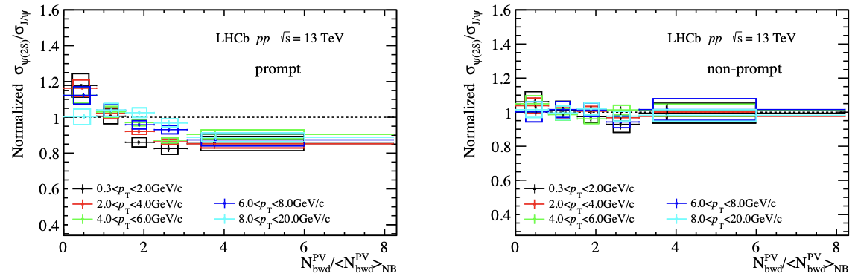
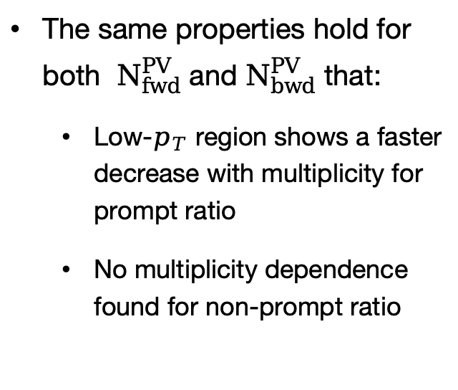
Result in different $p_{T}$ bin
The same properties hold for both $N_{fwd}^{PV}$ and $N_{bwd}^{PV}$ that:
Low-$p_{T}$ region shows a faster decrease with multiplicity for prompt ratio
No multiplicity dependence found for non-prompt ratio
LHCb preliminary
LHCb preliminary
LHCb preliminary
LHCb preliminary
From: LHCb-PAPER-2023-035

Slide 18
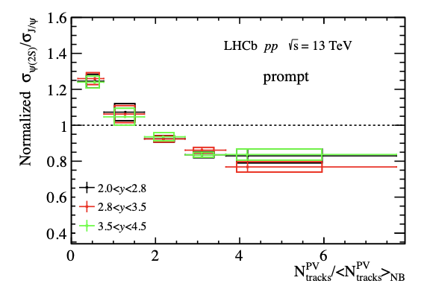
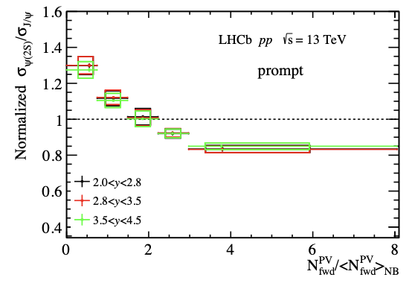
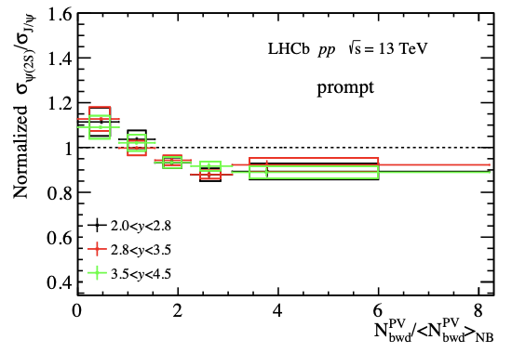
Result in different rapidity bin
Ratio of prompt production as function of multiplicity in different rapidity bin:
LHCb preliminary
LHCb preliminary
LHCb preliminary
From: LHCb-PAPER-2023-035
The suppressions for both charmonia in different rapidity region are almost the same.

Slide 19
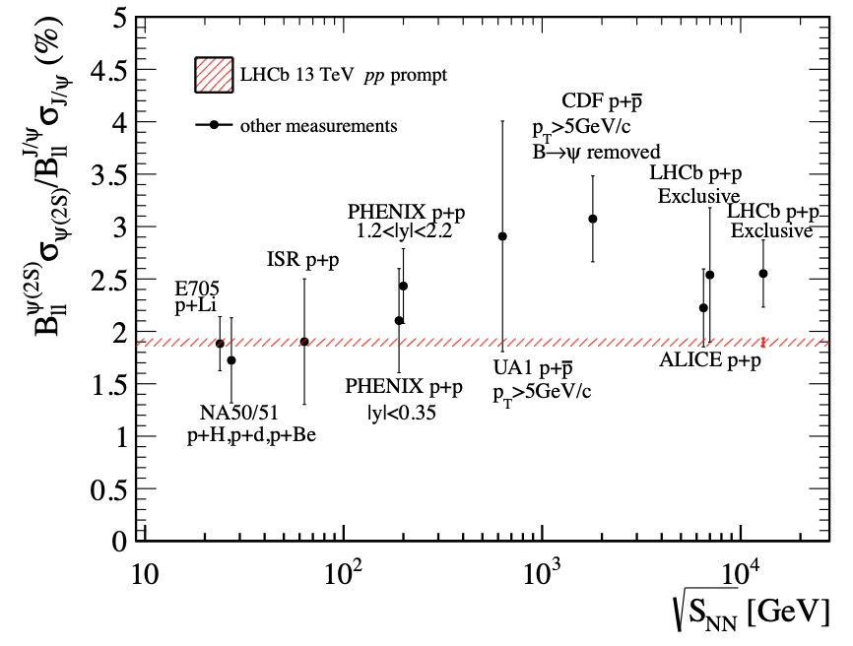
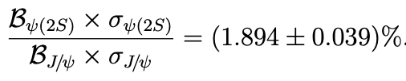
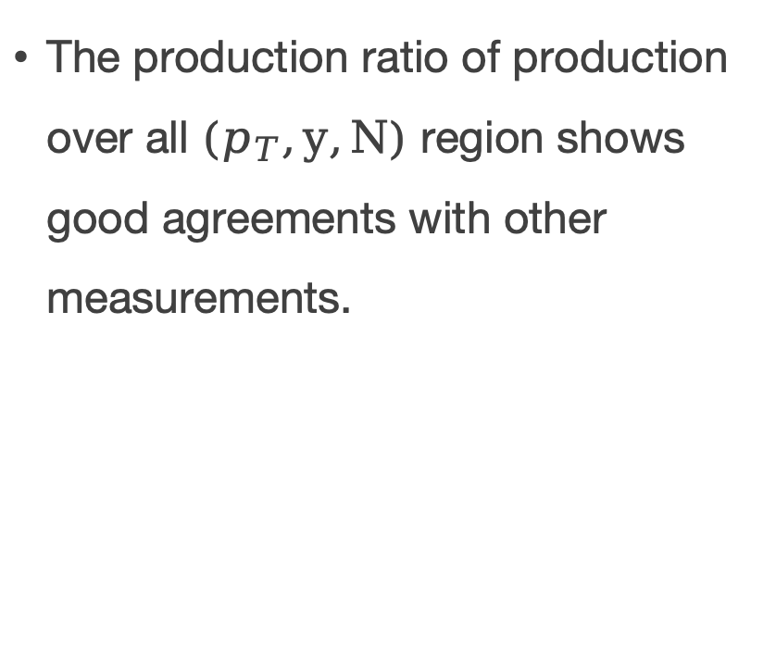
Comparison to world data
The production ratio of production over all $(p_{T},y,N)$ region shows good agreements with other measurements.
LHCb preliminary
From: LHCb-PAPER-2023-035

Slide 20
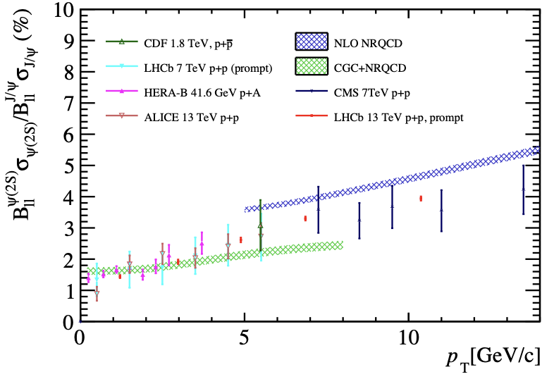
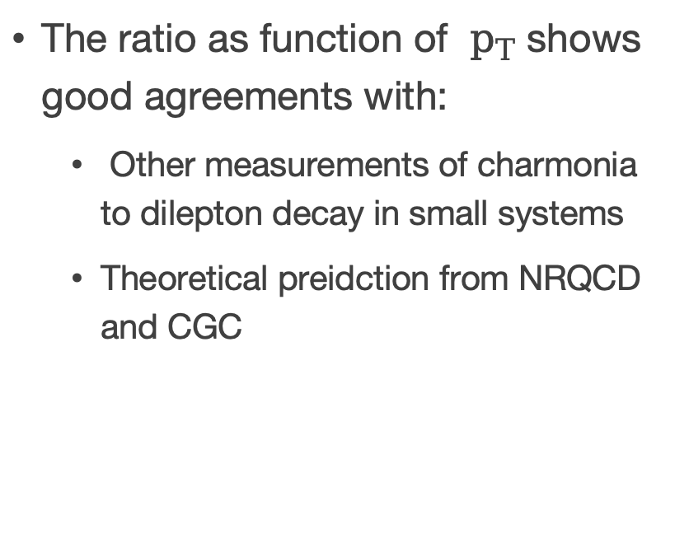
Comparison to world data
The ratio as function of $p_{T}$ shows good agreements with:
Other measurements of charmonia to dilepton decay in small systems
Theoretical preidction from NRQCD and CGC
LHCb preliminary
From: LHCb-PAPER-2023-035

Slide 21
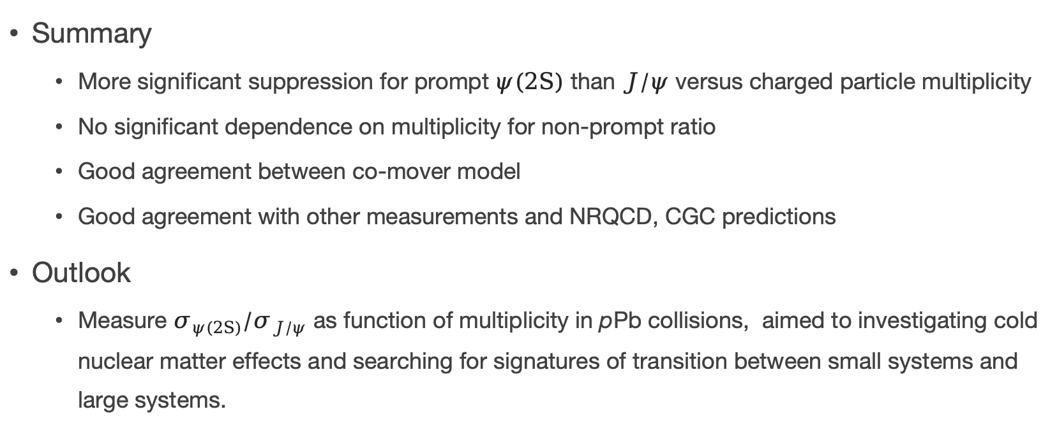
Summary & Outlook
Summary
More significant suppression for prompt $ψ(2S)$ than $J/ψ$ versus charged particle multiplicity
No significant dependence on multiplicity for non-prompt ratio
Good agreement between co-mover model
Good agreement with other measurements and NRQCD, CGC predictions
Outlook
Measure $σ_{ψ(2S)}/σ_{J/ψ}$ as function of multiplicity in pPb collisions, aimed to investigating cold nuclear matter effects and searching for signatures of transition between small systems and large systems.

Slide 22
Thanks for listening!

Slide 23
Back Up

Slide 24
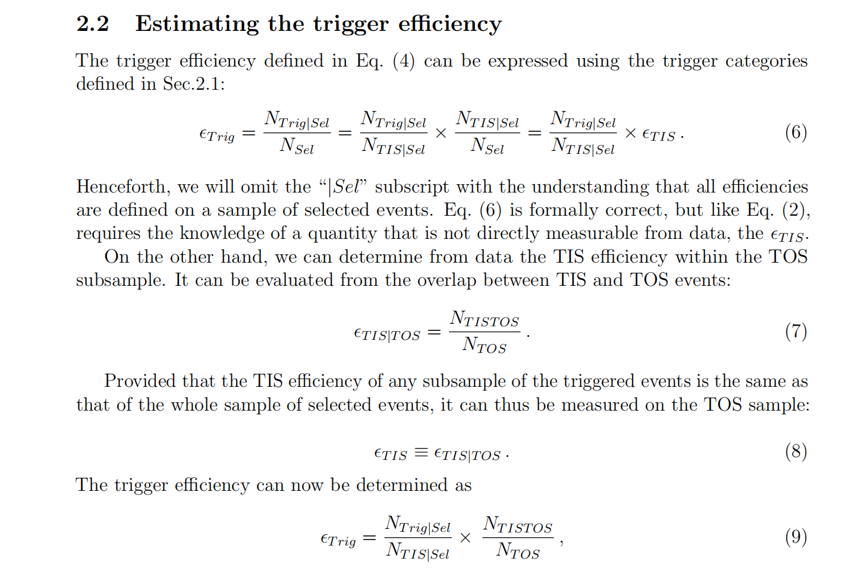
TISTOS method
LHCb-PUB-2014-039

Slide 25
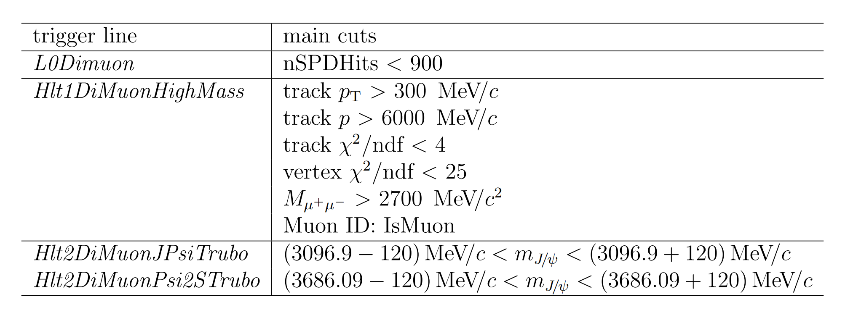
Trigger Line Cut

Slide 26
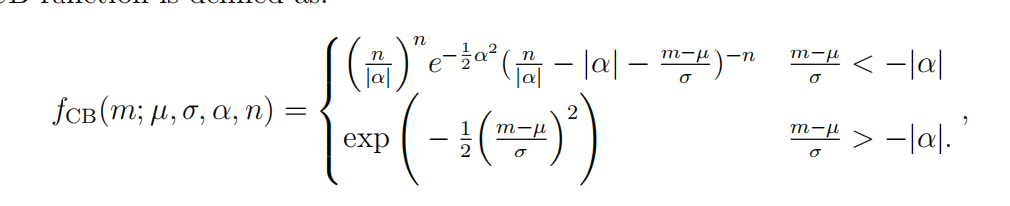
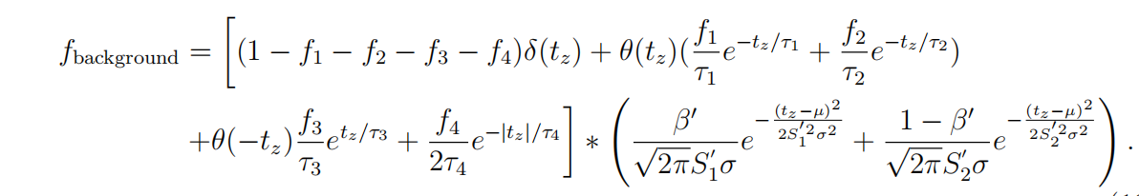
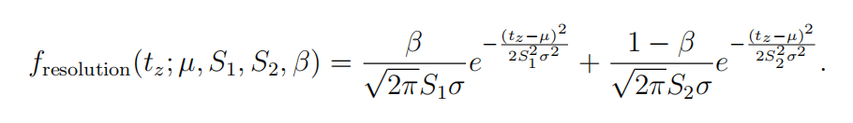
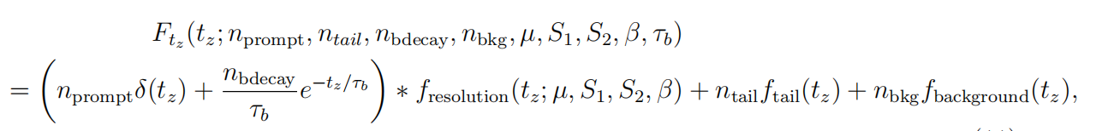
Formula for fit pdf

Slide 27
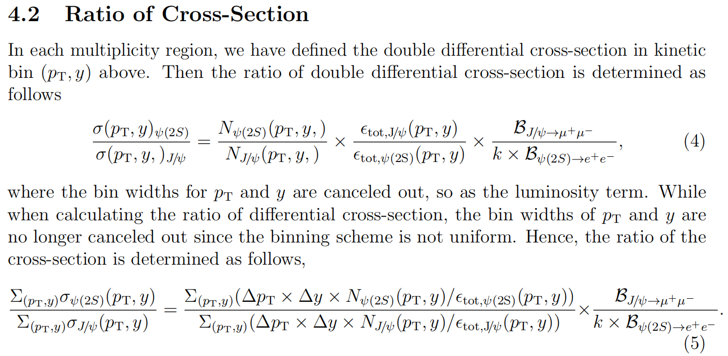
Cross section determination

Slide 28

Background fit
sideband sample: at least 60MeV from the center of the mass

Slide 29

certer of bin
Notes:
the distributions of multiplicity skew a lot so that in a certain bin,
the center of the bin may not represent an ideal horizontal coordinate for plotting the
results, especially for the small and large multiplicity regions. To study the effect, 10000
fitting trials are done in Monte Carlo. In each trial, in a certain multiplicity region of the
three different binning schemes (PVNTRACKS, nForwardTracks, and nBackTracks), we
randomly sample the mean values of the multiplicity region from a Gaussian sampling,
within each bin, mean being the content of the bin and width being the error of the bin.
fit. Since the data point is a ratio between two species, J/ψ, and ψ(2S), the average value for the ratio is weighted by the inverse of the square of the uncertainties (following the PDG weighted average procedure).

Slide 30
Correlation back&Forward

Slide 31

Long tag&probe method

Slide 32

Efficiency
PIDCalib package
Notes:
Then the production is corrected by efficiency.
Where the total efficiency consist of four parts.
The geometrical acceptance,
reconstruction and selection efficiency.
And the Muon ID efficiency is obtained using simulated samples calibrated with the data using the PIDCalib package.
And finally the trigger efficiency.
Below is the difinition for efficiencies of all kind.

Slide 33


high-, low-multiplicity pt-y reweight

